Slide 1

IPL Data Analysis
Royal Challengers Bangalore
Auction Strategy 2017
Made By: Shubham Singh

Slide 2
Problem Statement
You are hired as a sport data analyst by RCB where the team is looking for top-performing and reliable players to win tournaments, considering both on-field performance and value for money in mega player auction of 2017.
Your task is to come up with strategies/suggestions regarding selecting the best-performing players and optimizing player auction investments.

Slide 3
DATA OVERVIEW
Matches: 255 records covering toss results, winners, venues, and seasons.
Season: 9 seasons (2008–2016) including Orange/Purple Cap data.
Venue: 35 grounds across India and international locations.
Outcome: Categories for match results (Win, Tie, No Result).
Win_By: Methods of victory (By Runs or By Wickets).
18 Tables
Ball_by_Ball: 37,284+ granular records of every delivery, run, and player involved.
Wicket_Taken: Detailed dismissal data (Who, How, and which ball).
Extra_Runs: Tracking of all wides, no-balls, and byes per delivery.
Extra_Type: Classification of extras (Leg-bye, Wide, etc.).
Out_Type: Categorization of dismissals (Caught, Bowled, LBW, etc.).
469 Players
9 Seasons
Player: Biographic data for 469 players, including DOB and skills.
Team: 13 franchises, including RCB (Team_Id = 2).
Player_Match: Mapping of which player represented which team in specific matches.
Rolee: Definitive player roles (Batsman, Bowler, All-rounder).
255 Matches
  Batting_Style / Bowling_Style: Specific technical descriptions
  (Right-hand, Left-arm fast, etc.).
  Toss_Decision: Strategic data on Bat vs. Field choices.
  Umpire: Names and nationalities of match officials.

Slide 4
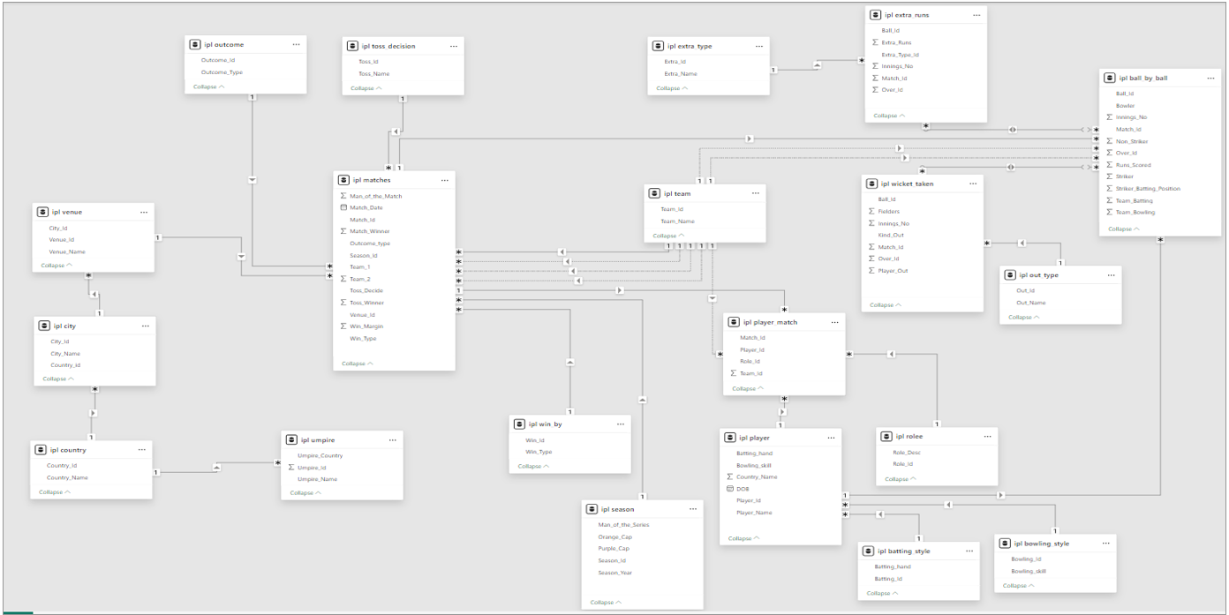
DATABASE SCHEMA

Slide 5
METHODOLOGY
Data Setup: Loaded ipl_1.sql & ipl_2.sql. Verified all 18 tables loaded correctly
SQL Analysis: Subjective and objective queries using JOINs, CTEs, Window Functions, CASE WHEN
KPI Derivation: 5 custom KPIs: powerplay rate, death rate, economy, dot ball %, boundary%
Recommendations: Composite score model (Avg × SR / 100) to build RCB Dream XI

Slide 6
TOP 10 PLAYERS BY STRIKE RATE
AB de Villiers leads with 163.74 SR across 1,194 balls, elite volume and aggression combined
AD Russell (163.16) and GJ Maxwell (156.70) are explosive finishers who change matches single-handedly
DA Warner scores the most runs (2,348) at 141 SR, best combination of volume and speed
Note: Minimum 200 balls filter applied to ensure statistical reliability

Slide 7
Most Consistent Batsmen: Avg runs per season
V Kohli (618 avg/season, min 359, max 969): Even in his worst season Kohli scored 359 runs. That's more than most players score in their best season. Absolute consistency
DA Warner (587 avg/season, min 410): Warner's minimum is 410, he has literally never had a bad season. The most floor-proof batsman in this list
AB de Villiers (492 avg/season, min 373): Third in consistency. Combined with his 163-strike rate from Q5, ABD is the complete package across every metric
CH Gayle (408 avg, min 196): Biggest gap between min and max (196 to 720) shows Gayle is either brilliant or disappointing. High ceiling but inconsistent floor risky auction pick

Slide 8
AVERAGE WICKETS PER MATCH (MIN. 10 MATCHES)
Imran Tahir (2.21 avg, 31 wickets): Highest average in the list. Tahir's leg spin and googlies are genuinely unplayable on good days, 31 wickets in just 14 matches is exceptional. Real life backs this up : he's one of the most feared spinners in world T20 cricket
JJ Bumrah (2.00 avg, 30 wickets): Even in 2016 it was clear Bumrah was something special. 2 wickets per match consistently across 15 games, his unorthodox action and perfect yorkers make him unplayable in death overs. The data spotted a future world number one early
DJ Bravo (1.93 avg, 81 wickets): The most wickets in this entire list. 81 wickets across 42 matches shows Bravo isn't just good occasionally, he's a reliable wicket-taker every single game. His slower balls and variations at the death are world class

Slide 9
ALL-ROUNDERS: ABOVE AVERAGE IN BATTING
Analysis identifies 22 genuine all-rounders who perform above the overall average in both batting and bowling.
CH Gayle leads with 33.35 avg runs while MP Stoinis and DJG Sammy lead bowling with 2.25 and 2.33 avg wickets respectively.
AD Russell stands out as the most balanced all-rounder combining batting (22.91) with consistent wicket-taking (1.84).

Slide 10
RCB WINS & LOSSES AT EACH VENUE
M Chinnaswamy Stadium is RCB's fortress: 29 matches, 16 wins, 55.17%-win rate. Most matches played here by far showing it's RCB's primary home ground
2 matches had No Result at Chinnaswamy: these were rain-affected games. This is why Wins + Losses is not equals to Total Matches, important data quality observation
Feroz Shah Kotla and Maharashtra CA Stadium show 100%-win rates but with only 2 matches each, too small a sample to be statistically meaningful
Rajiv Gandhi Stadium and Wankhede are RCB's worst away venues, both showing 25%-win rate across 4 matches each. RCB clearly struggles at these grounds

Slide 11
KPI FOR TEAM STRATEGY

Slide 12
KPI FOR TEAM STRATEGY

Slide 13
KPI FOR TEAM STRATEGY

Slide 14
MOST CONSISTENT BATSMEN ACROSS SEASONS
V Kohli (618 avg/season, min 359, max 969): Even in his worst season Kohli scored 359 runs. That's more than most players score in their best season. Absolute consistency
DA Warner (587 avg/season, min 410): Warner's minimum is 410, he has literally never had a bad season. The most floor-proof batsman in this list
AB de Villiers (492 avg/season, min 373): Third in consistency. Combined with his 163-strike rate from Q5, ABD is the complete package across every metric
CH Gayle (408 avg, min 196): Biggest gap between min and max (196 to 720) shows Gayle is either brilliant or disappointing. High ceiling but inconsistent floor risky auction pick

Slide 15
HOW DOES TOSS AFFECT MATCH RESULTS
Teams choosing to field first win 54.84% of matches compared to only 43% when choosing to bat, clearly fielding first is the smarter toss decision in T20 cricket overall
255 total matches analysed: 155 times teams chose to field, 100 times chose to bat. Fielding first is already the preferred choice and the data confirms it's the right one
MA Chidambaram Stadium, Chepauk shows the most extreme toss impact batting first wins only 25% while fielding first wins 72.73%. Chennai's slow turning pitch heavily favors chasing teams
Wankhede Stadium: fielding first wins only 41.67% but batting first wins 64.29%. Complete opposite of the overall trend! At Wankhede batting first is actually better dew factor in evening games makes chasing harder
M Chinnaswamy Stadium: fielding first wins 51.85% vs batting first 33.33%. RCB's home ground clearly favors chasing, flat pitch scores big totals and teams prefer chasing at Chinnaswamy

Slide 16
MATCH WINNERS
DA Warner (11 MOTM, 4 seasons): Most match-winning performances in entire dataset. Warner is the kind of player who takes over games and makes winning look easy, his energy and aggressive batting set the tone for his entire team
AB de Villiers (9 MOTM, 4 seasons): Joint second overall AND RCB's own player. Every time ABD wins MOTM the entire RCB dressing room feeds off that energy, his match-winning ability is RCB's biggest morale booster
V Kohli (9 MOTM, 3 seasons): Matches Warner's MOTM count but in one fewer season, showing Kohli is even more impactful per season. As captain his MOTM performances directly inspire the entire team
AM Rahane (10 MOTM, 4 seasons): Surprising second place! Rahane's calm demeanor and match-winning innings show that consistent performers rather than flashy players often have the most impact on team morale

Slide 17
RCB 2017 MEGA AUCTION STRATEGY
Order | Role | Player | Avg Runs | Strike Rate | Avg Wickets | Economy | Composite Score
1 | Opener | V Kohli | 39.87 | 135.68 | — | — | 54.09
2 | Opener | DA Warner | 38.49 | 140.94 | — | — | 54.25
3 | Middle Order | AB de Villiers | 34.53 | 164.27 | — | — | 56.72
4 | Middle Order | CH Gayle | 33.35 | 137.43 | — | — | 45.83
5 | All-rounder | AD Russell | 22.91 | 163.16 | 1.84 | 7.71 | 37.38
6 | All-rounder | SR Watson | 24.81 | 131.11 | 1.74 | 7.39 | 32.54
7 | All-rounder | RA Jadeja | 13.4 | 117.96 | 1.93 | 7.58 | —
8 | Bowler | JJ Bumrah | — | — | 2 | — | —
9 | Bowler | SP Narine | — | — | 1.84 | 6.24 | —
10 | Bowler | DJ Bravo | — | — | 1.93 | 7.77 | —
11 | Bowler | SL Malinga | — | — | 1.83 | 6.58 | —
Retain V Kohli and AB de Villiers: combined composite score of 110.81. No other pair in IPL history matches this combination of consistency and aggression. Non-negotiable retentions before auction even begins
Sign DA Warner as opener: 54.25 composite score, 11 MOTM awards, never had a bad season (min 410 runs). Warner + Kohli opening partnership would be the most feared combination in IPL 2017
Target AD Russell as finisher: 163.16 SR batting + 1.84 wickets bowling + 35 wickets in career. Russell fills the death-over batsman AND death-over bowler role simultaneously, double value in one purchase

Slide 18
CONCLUSION
RCB's batting lineup is already elite: Led by top performers like Kohli, ABD, and Warner across all key metrics, there is no need to over-allocate resources here.
Bowling performance has dropped for four consecutive seasons: Total wickets fell from 78 in 2013 to 71 in 2016, making this the primary area requiring urgent reinforcement.
Home advantage exists but remains underleveraged: Winning at a 55% rate at Chinnaswamy can be elevated past 65% by recruiting the right personnel.
All-rounders provide the highest strategic value: Players like Russell, Watson, and Jadeja cover multiple requirements, ensuring maximum efficiency per investment.
Prioritize empirical data over public hype: Long-term consistency over four seasons and composite performance ratings consistently outperform mere reputation.
RCB has come close three times. The data shows exactly what's missing. 2017 is the year to get it right.

